Slide 1
Overview of Project
This project focuses on the analysis of a Spotify dataset containing various audio features for songs, with the aim of predicting the popularity of tracks in the future.
Models we used in this project:
XGBoost
Voting Classifier (Ensemble Method)
Random Forest Classifier
Reasons:
Ensemble methods for nonlinear relationships.
RFC works great for classification tasks.
XGBoost is highly optimized and works well even with large datasets.
https://www.kaggle.com/datasets/maharshipandya/-spotify-tracks-dataset/data

Slide 2
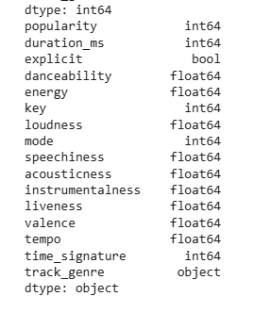
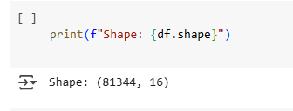
About Dataset
The dataset consists of 81,344 tracks from Spotify, spanning 16 original features such as audio attributes, track metadata, and popularity. The target column is popularity, with values between 0 and 100, representing the song’s popularity based on plays and user engagement.

Slide 3


Exploratory data analysis

Slide 4
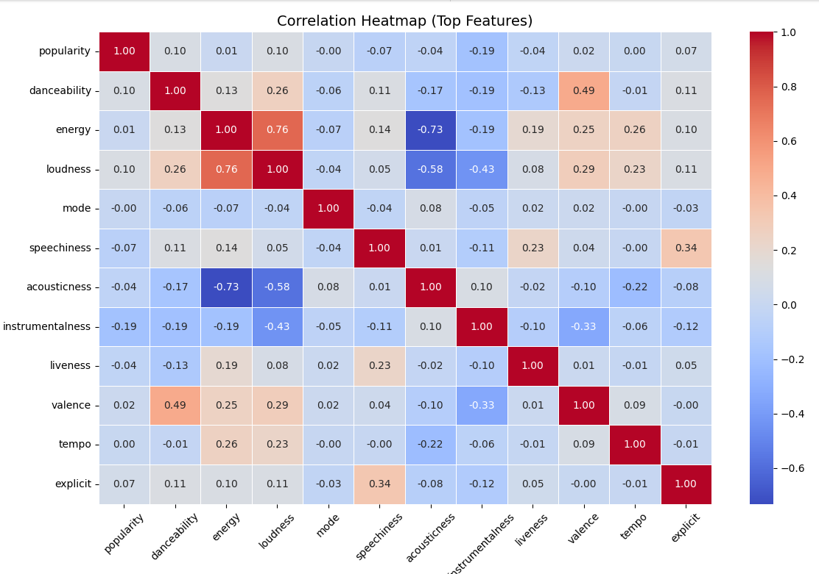
This heatmap reveals that Danceability, Energy, and Loudness have moderate positive correlations with song Popularity.
Notes:
This heatmap reveals that Danceability, Energy, and Loudness have moderate positive correlations with song Popularity, indicating that energetic and rhythmic songs are more likely to be well-received. In contrast, features like Acousticness, Instrumentalness, and Speechiness show weak or negative correlations, suggesting they contribute less to mainstream appeal.

Slide 5
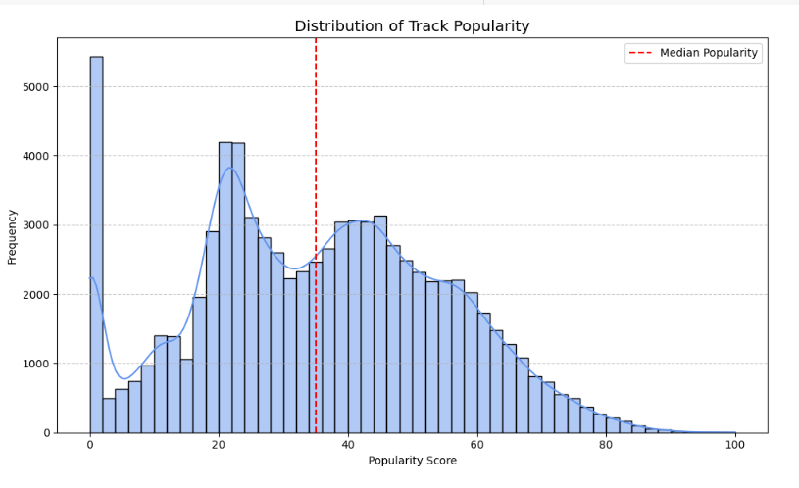
EDA for popularity
most Spotify tracks have low to moderate popularity scores, with a median around 35
Notes:
This histogram shows the distribution of track popularity in the Spotify dataset, with a clear skew toward lower popularity scores. The red dashed line marks the median popularity, indicating that over half of the songs fall below this score, emphasizing a concentration of less popular tracks in the dataset.

Slide 6
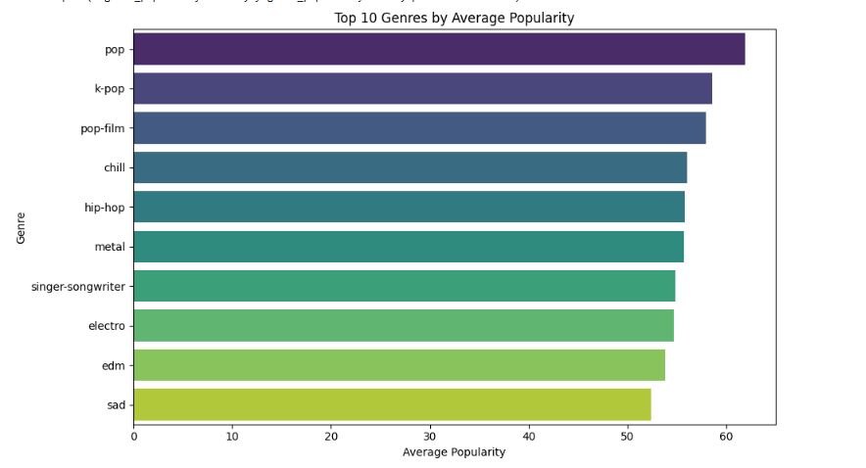
EDa for the most popular genres
‍🎤 K-pop, Pop-film, and Chill follow closely with scores ~57-59.

Slide 7
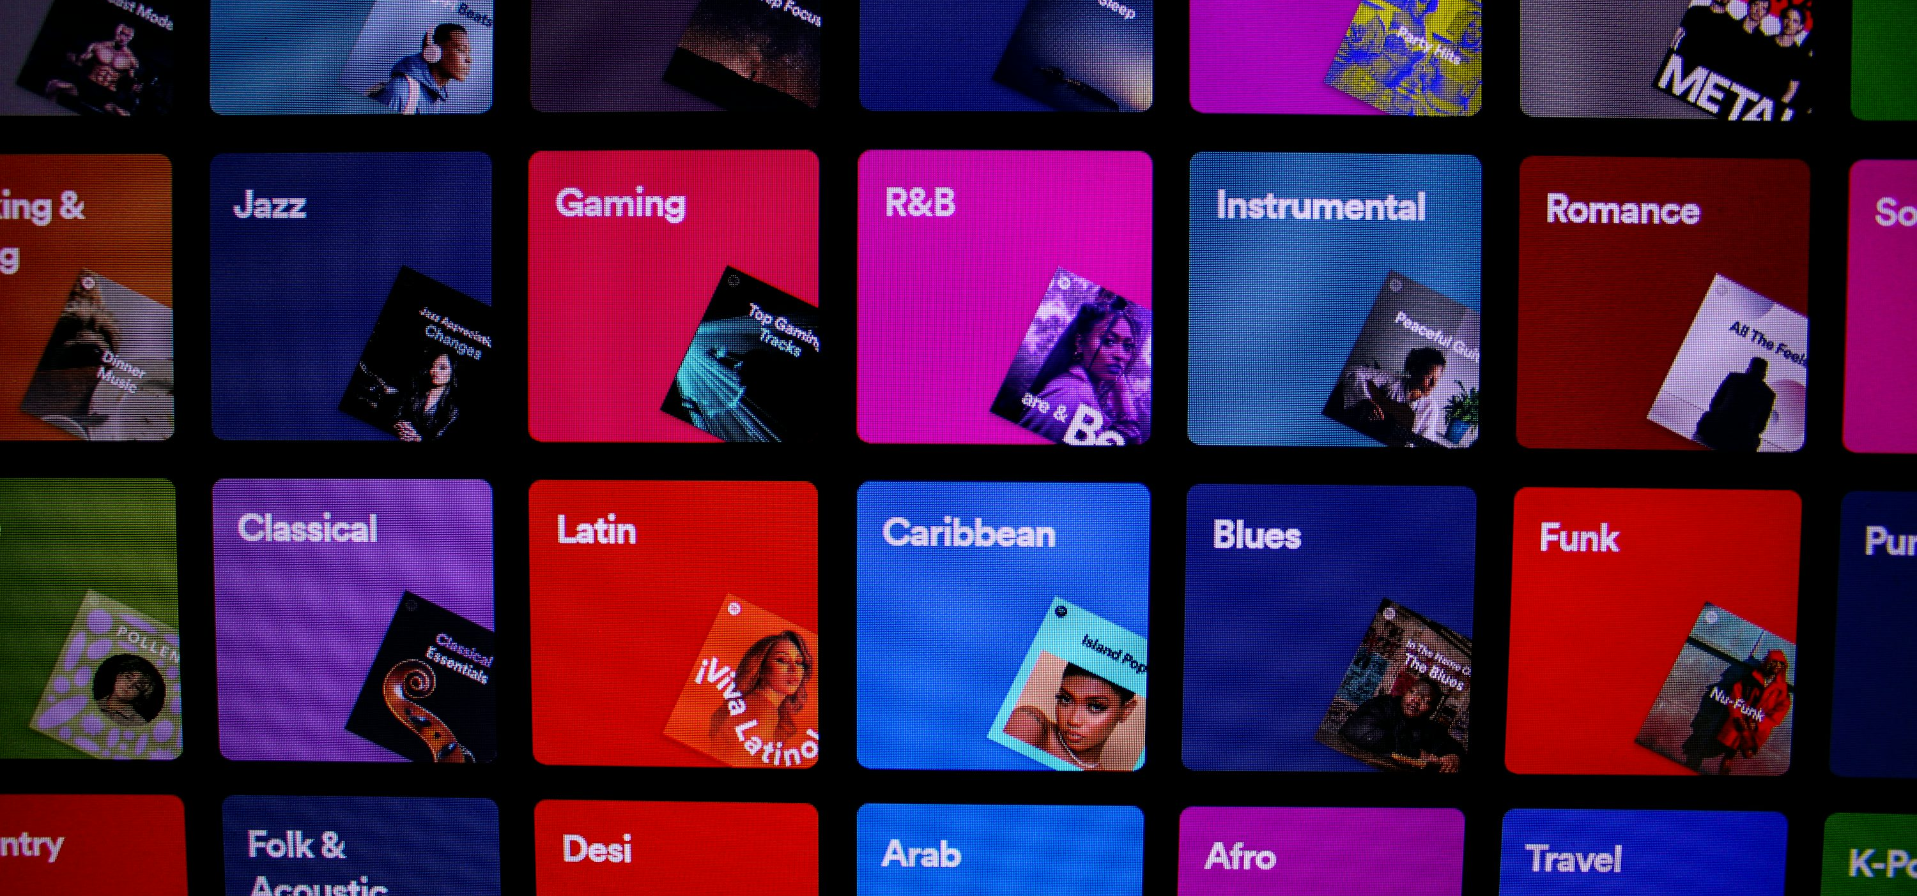

Data Preprocessing & Data Models

Slide 8

DATA PREPROCESSING Process AND CLEANING
Data Preprocessing:
Dropped irrelevant columns (like IDs, links, etc.) to reduce noise.
Encoded categorical features (e.g., mode, key, genre) into numerical values.
Used MinMaxScaler to normalize numeric features and prevent scaling issues.
Applied SMOTE (Synthetic Minority Over-sampling Technique) to balance class distribution by generating synthetic samples of the minority class (unpopular tracks).
Created a binary target by converting the continuous popularity score into two classes: 1 = Popular (≥ median) and 0 = Not Popular (< median) — for binary classification.

Slide 9

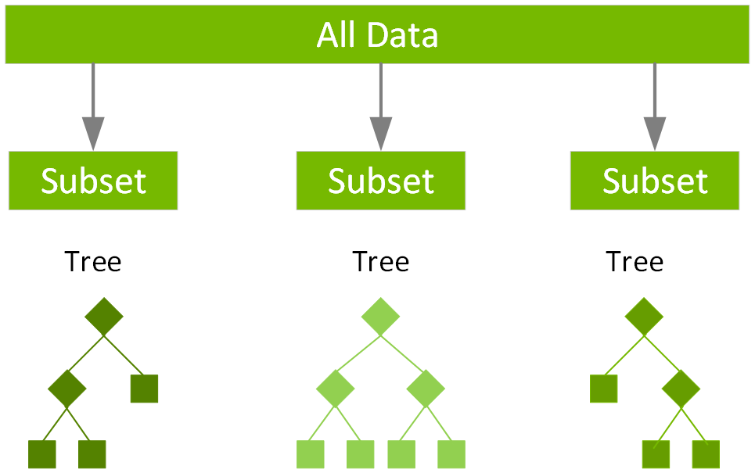
MODEL 1 XGBoost: Extreme Gradient Boosting Algorithm
Definition
XGBoost stands for extreme Gradient Boosting.
Key Principle
Builds small sequential decision trees where each tree corrects the errors of the previous ones.
Why It's Popular
Fast, scalable, and memory-efficient
Delivers strong results on structured/tabular data
Highly customizable with many hyperparameters

Slide 10
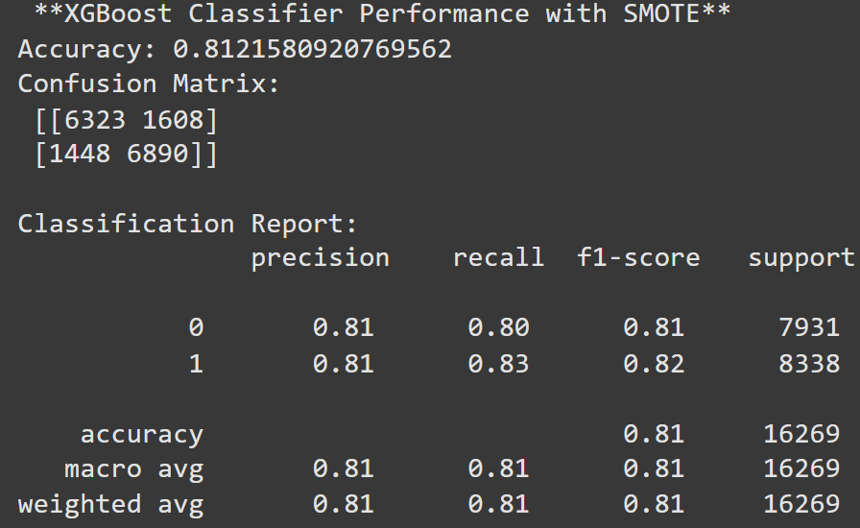
XGBoost Performance on Spotify Dataset
Accuracy (0.8122): Out of 16,269 tracks, XGBoost correctly classified 13,213 as either popular or not popular.
F1 Score (~0.81): Balances both precision and recall, meaning the model is reliable at identifying both classes with minimal bias.
XGBoost effectively caught most popular songs and avoided many mistakes — maintaining balance and generalization, largely due to SMOTE.
We used SMOTE to balance the data by generating more samples of less frequent classes. This helped XGBoost, Voting Classifier and Balanced RF learn better from both types of songs.

Slide 11
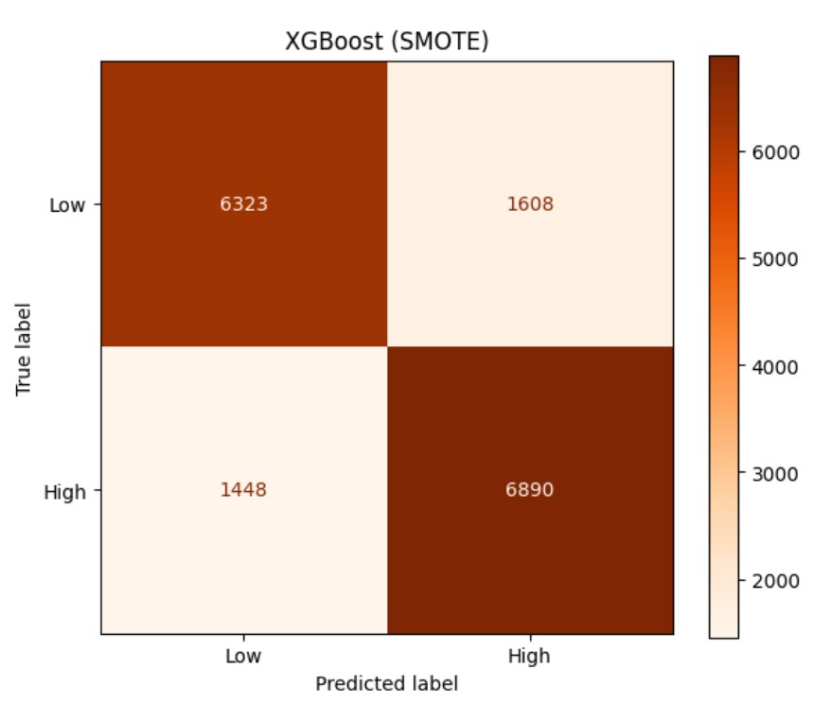
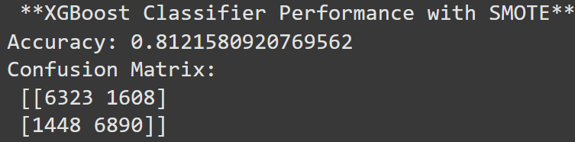
XGBoost Confusion Matrix Breakdown
The model correctly predicted 13,213 out of 16,269 tracks.
Confusion Matrix Breakdown:
True Negatives (TN): 6,323
True Positives (TP): 6,890
False Positives (FP): 1,608 — non-popular songs misclassified as popular
False Negatives (FN): 1,448 — popular songs missed by the model
XGBoost delivers balanced and consistent performance, with strong precision and recall across both classes.

Slide 12
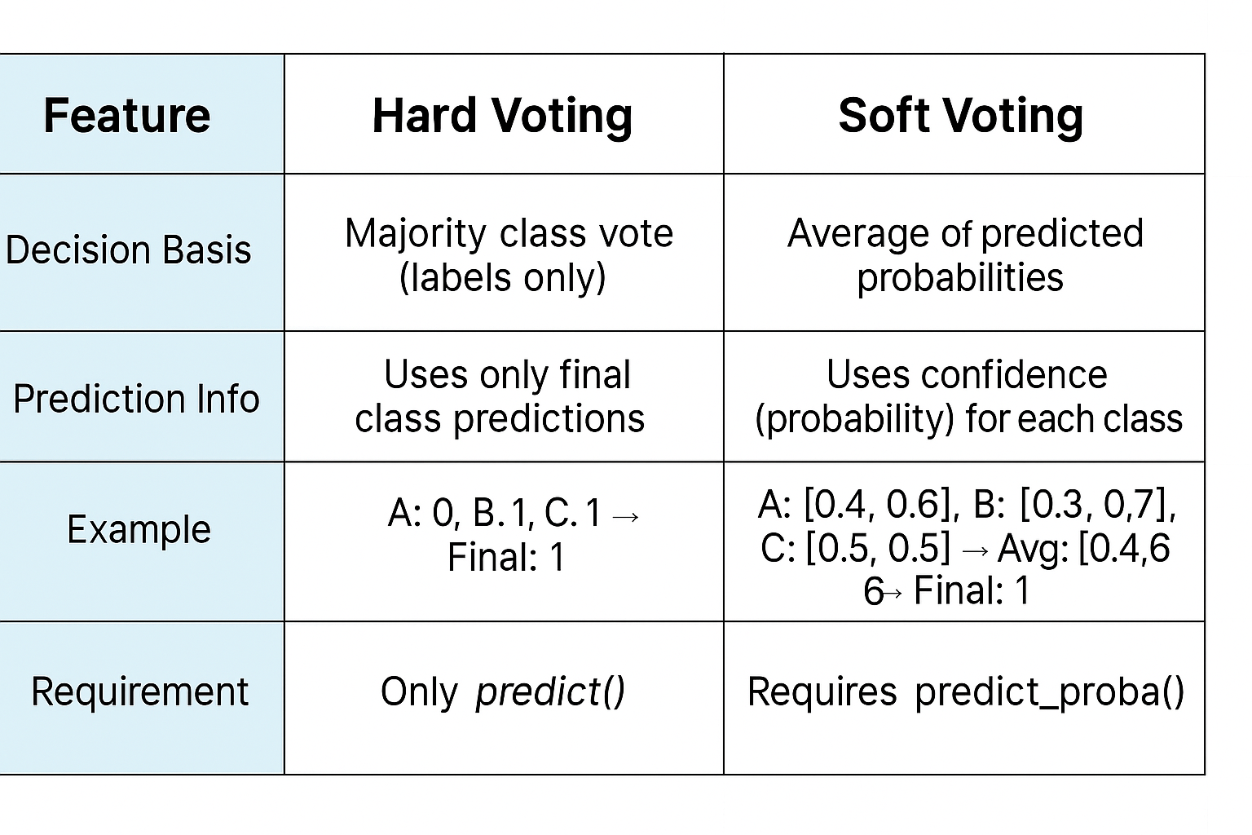
MODEL 2 Voting Classifier
Definition: A Voting Classifier is an ensemble machine learning model that combines the predictions of multiple different classifiers to improve overall performance.
Why Voting Classifier?
Combines Logistic Regression, XGBoost, Random Forest
Balances model diversity
Improve predictive accuracy and stability
Reduces the risk of overfitting
Why Soft voting?
More accurate: considers how confident each model is
Works well with imbalanced data (combined with SMOTE)
All selected models support probability prediction
Better overall performance in testing

Slide 13
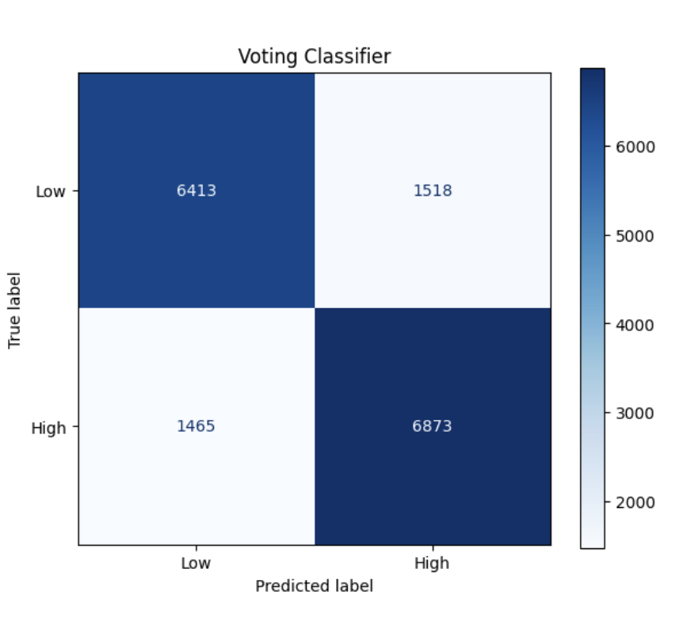
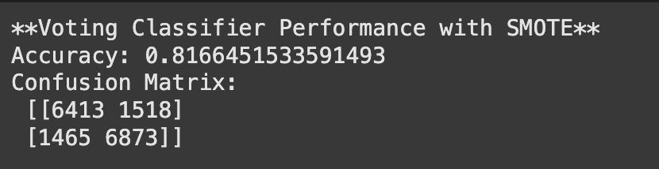
Voting Classifier confusion matrix break down
The model correctly predicted 13,259 out of 16,269 tracks (TN + TP = 6431 + 6873).
False Positives (1518): Non-popular songs misclassified as popular.
False Negatives (1465): Popular songs missed by the model.

Slide 14
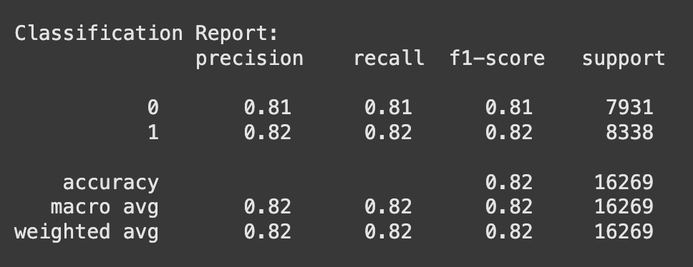
Voting classifier Performance on Spotify dataset
Accuracy: The model achieved an overall accuracy of 82%, meaning it correctly classified 82% of all tracks in the test set (13,192 out of 16,269 samples).
F1-Score:
Class 0 (non-popular) F1-score: 0.81
Class 1 (popular) F1-score: 0.82
This shows the model performs consistently well across both classes.
Effect of Using SMOTE
the F1-score for the positive class increased to 0.82.
Accuracy remained above 81%: The model improved its ability to detect the minority class
The model became less likely to miss popular songs (class 1) → resulting in fewer false negatives.

Slide 15

MODEL 3 BALANCED RANDOM FOREST
Definition: a variant of the traditional Random Forest Classifier, but it includes class balancing techniques during the model training process.
Key Principle: During each tree construction, it randomly under-samples the majority class to match the minority class.
Why It’s Popular:
Reduces bias by balancing the classes within each tree.
Best for Highly imbalanced datasets.
More balanced, less biased predictions
Data Preprocessing:
Dropped irrelevant columns (IDs, etc.).
Encoded categorical features (mode, key, genre).
Used MinMaxScaler to normalize numeric features.
SMOTE

Slide 16
MODEL 3 BALANCED RANDOM FOREST
What's the difference between RF and Balanced RF?
Aspect | RandomForestClassifier | BalancedRandomForestClassifier
Library | scikit-learn | imblearn (imbalanced-learn)
Sampling Method | Bootstrapping from the entire dataset | Bootstrapping with balanced class sampling
Handling Imbalance | No specific handling (prone to majority bias) | Actively balances classes within each tree
Performance on Imbalanced Data | May be biased towards majority class | More balanced, less biased predictions
Use Case | Balanced or slightly imbalanced datasets | Highly imbalanced datasets

Slide 17
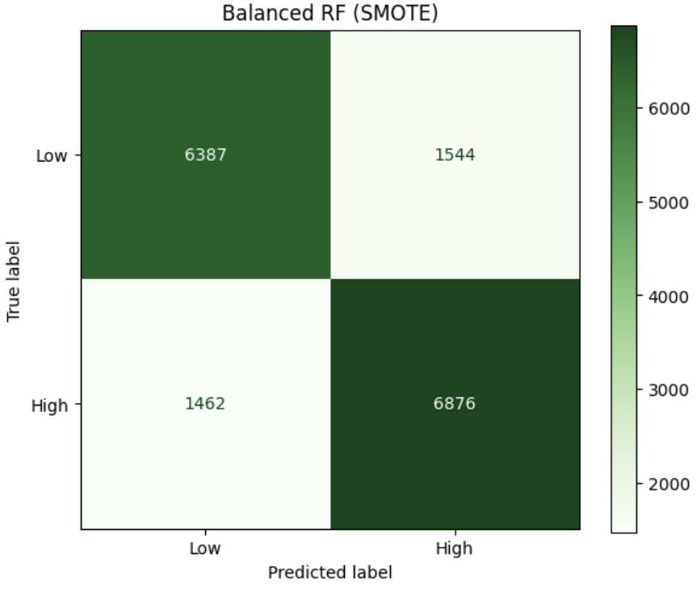
BALANCED RF Confusion Matrix Breakdown
The model correctly predicted 13,263 out of 16,269 tracks (TN + TP).
False Positives (1544): Non-popular songs misclassified as popular.
False Negatives (1462): Popular songs missed by the model.

Slide 18
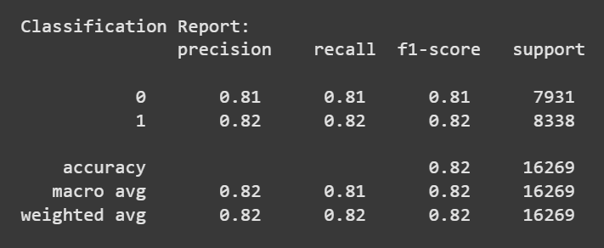
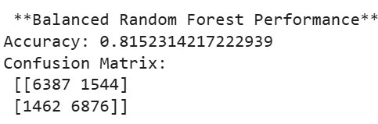
BALANCED RF Performance on Spotify dataset
Accuracy: 81.52% - The model correctly predicts the popularity status of tracks 81% of the time.
F1-Score: Around 0.81 for not popular and 0.82 for popular, indicating a balanced performance between precision and recall.

Slide 19

Training Models - Comparative Studies

Slide 20

MODEL Comparison Models: XGBoost, Voting Classifier and Balanced Random Forest
Accuracy & F1 Score Comparison
All three models achieved strong performance, with accuracy and F1 scores around 81%.
Voting Classifier stood out with the highest accuracy (81.66%) and balanced performance across both classes.
Model | Accuracy | F1 Scores
Voting Classifier | 0.8166 | 0.82
Balanced RF | 0.8152 | 0.82
XGBoost | 0.8122 | 0.81
Voting Classifier, powered by a blend of multiple models and trained with SMOTE, proved to be the most reliable and best-performing model for predicting track popularity.

Slide 21
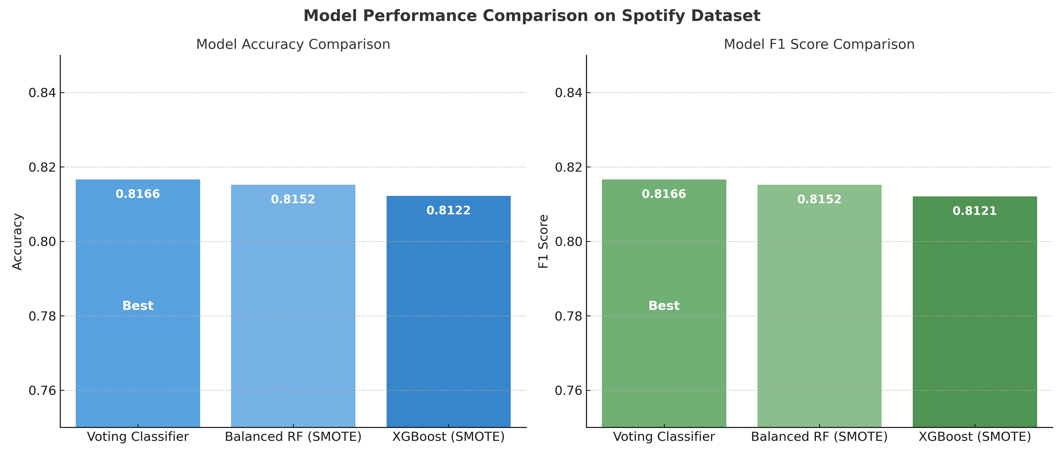

Slide 22

CONFUSION matrix breakdown
Confusion Matrix Breakdown of all the 3 models
Voting Classifier correctly predicted the most tracks overall, with the highest combined True Positives and True Negatives.
Although XGBoost predicted the most popular songs (TP = 6,890), it also had the highest number of False Negatives.
Model | True Positives | True Negatives | False Positives | False Negatives
Voting Classifier | 6,873 | 6,413 | 1,465 | 1,518
Balanced RF | 6,876 | 6,387 | 1,462 | 1,544
XGBoost | 6,890 | 6,323 | 1,448 | 1,608
These results show that all models performed well, but Voting Classifier balanced precision and generalization best, making the fewest overall mistakes.

Slide 23
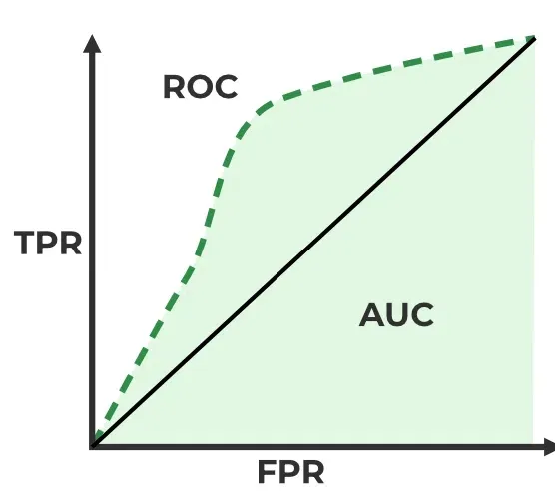
WHAT IS ROC & AUC
ROC (Receiver Operating Characteristic) Curve shows how well a model distinguishes between classes by plotting the True Positive Rate (TPR) against the False Positive Rate (FPR) at various threshold levels.
AUC (Area Under the Curve) measures the overall performance of the model.
AUC = 1.0 means perfect prediction
AUC = 0.5 means random guessing
Higher AUC = better model performance

Slide 24
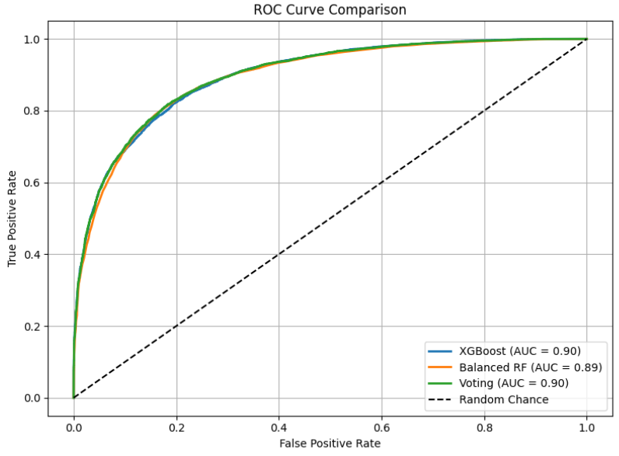
ROC-AUC COMPARISON
Voting Classifier and XGBoost both achieved the highest AUC of 0.90, demonstrating strong ability to distinguish between popular and non-popular tracks.
Confusion Matrix Breakdown

Slide 25


Best Model and Conclusion
Key Takeaways:
All three models (XGBoost, Voting Classifier, Balanced RF) performed well on the Spotify dataset after applying SMOTE to address class imbalance.
Models were evaluated using Accuracy, F1 Score, Precision, Recall, and AUC Score.
These models can help Spotify recommend underrated tracks by effectively predicting popularity—even when the data is imbalanced.
🏆 Best Performing Model: Voting Classifier (SMOTE)
Highest Accuracy: 81.66%
Best F1 Score: 81.66% — strong balance between precision and recall
AUC Score: 0.90 — excellent at distinguishing popular vs. non-popular tracks
Made the fewest total classification errors, showing consistent and reliable performance.

Slide 26

Tools and Resources used
Programming & Analysis
Python – Core language for data processing and modeling
Jupyter Notebook (Anaconda) – Local environment for developing and testing code
Google Colab – Cloud platform with GPU/TPU for training models with SMOTE
Data Handling & Visualization
Microsoft Excel – Early data inspection and filtering
Pandas, NumPy – Data cleaning, transformation, and feature engineering
Matplotlib, Seaborn – Visualization of trends, model performance, and EDA
Collaboration & Submission
OneDrive – Shared folder for submitting final work
Kaggle – Source for the Spotify dataset used
ChatGPT (OpenAI) – Assisted with code debugging, correcting visualizations, and research

Slide 27

APPENDIX- Bonus GRAPHS AND ANALYSIS

Slide 28
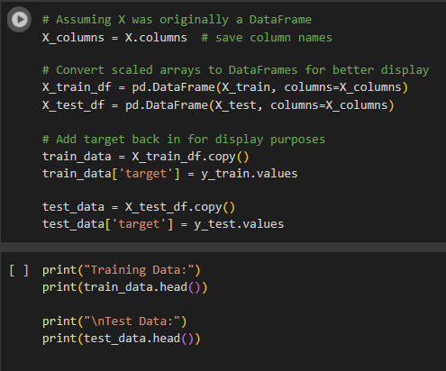
TRAINING DATA AND TEST DATA- Code

Slide 29
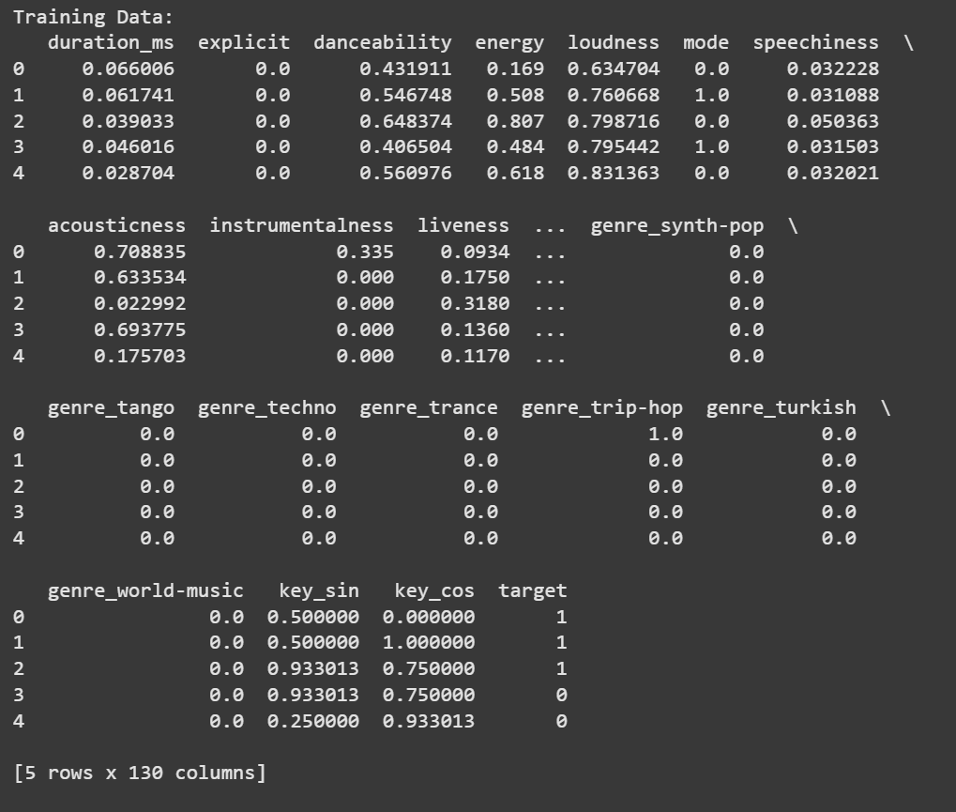
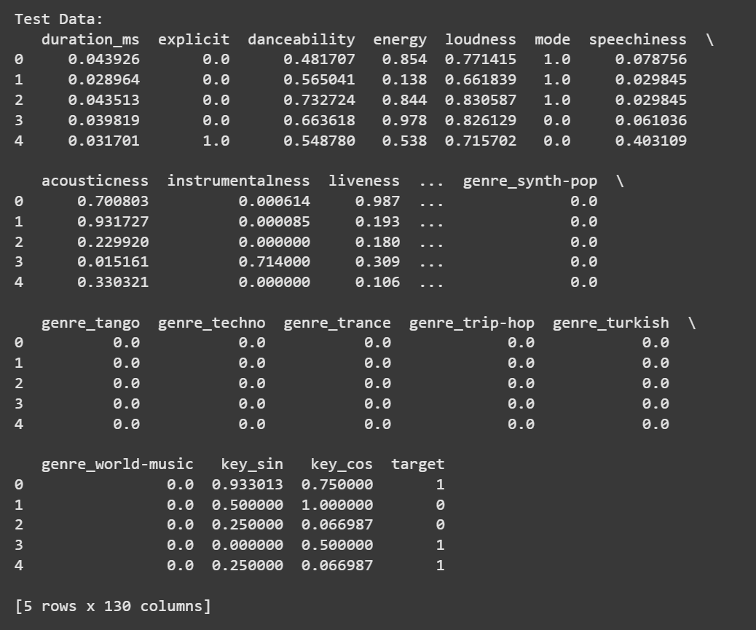
TRAINING DATA AND TEST DATA

Slide 30
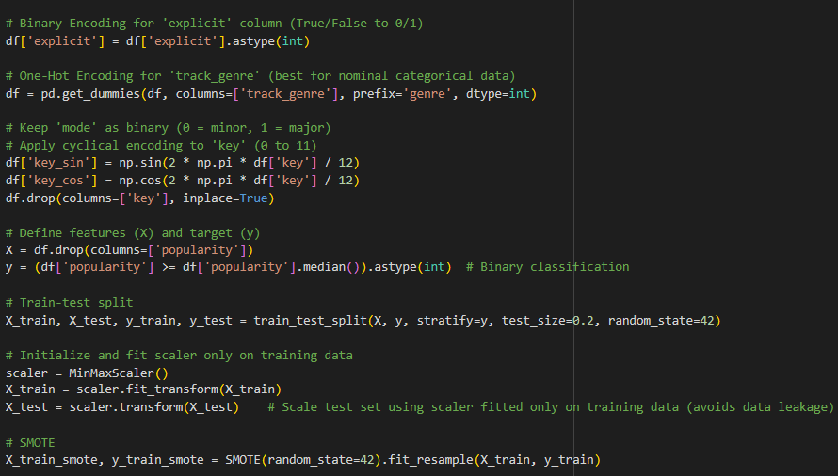
TRAINING MODELS - Code
Accuracy & F1 Score Comparison

Slide 31
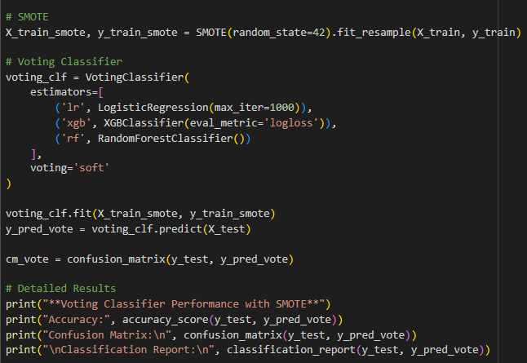
Voting Classifier with SMOTE & Results

Slide 32
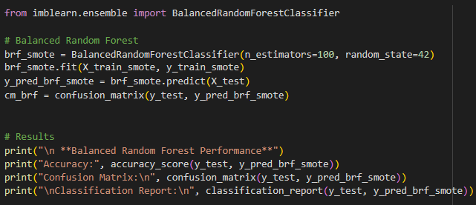
Balanced Random Forest Model and Results
Accuracy & F1 Score Comparison

Slide 33
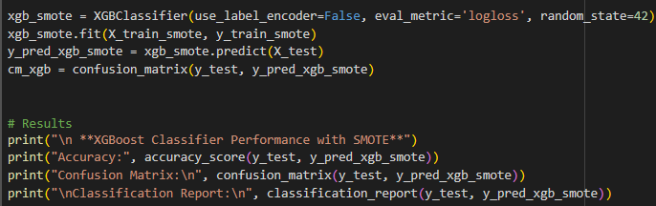
XGBoost Model and Results

Slide 34
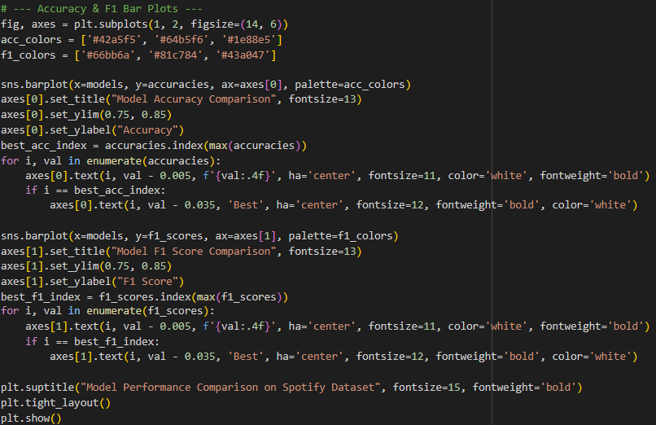
Visualizations- Accuracy and Bar plots

Slide 35
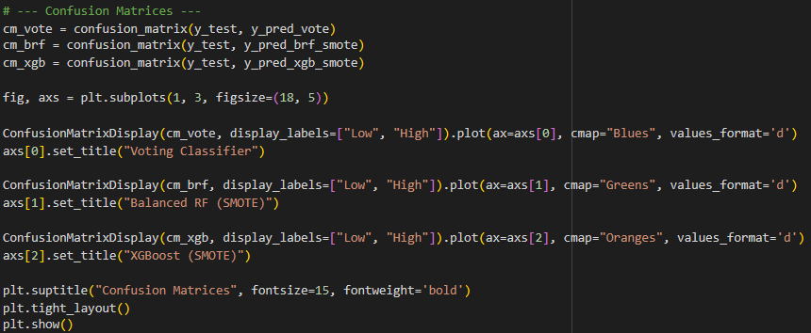
Visualizations- Confusion Matrices

Slide 36
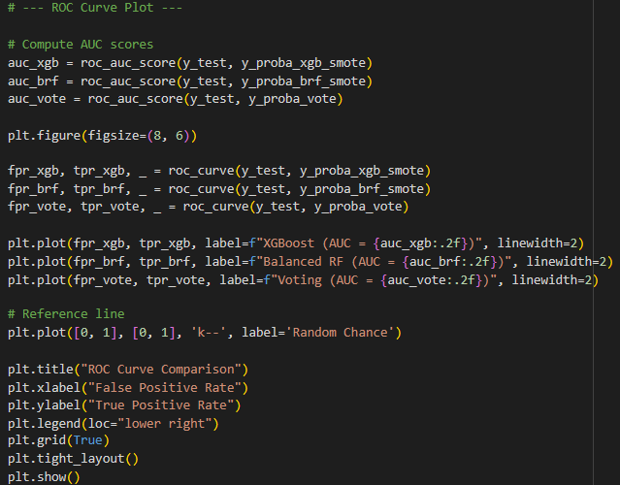
Visualizations- ROC Curve Plot

Slide 37
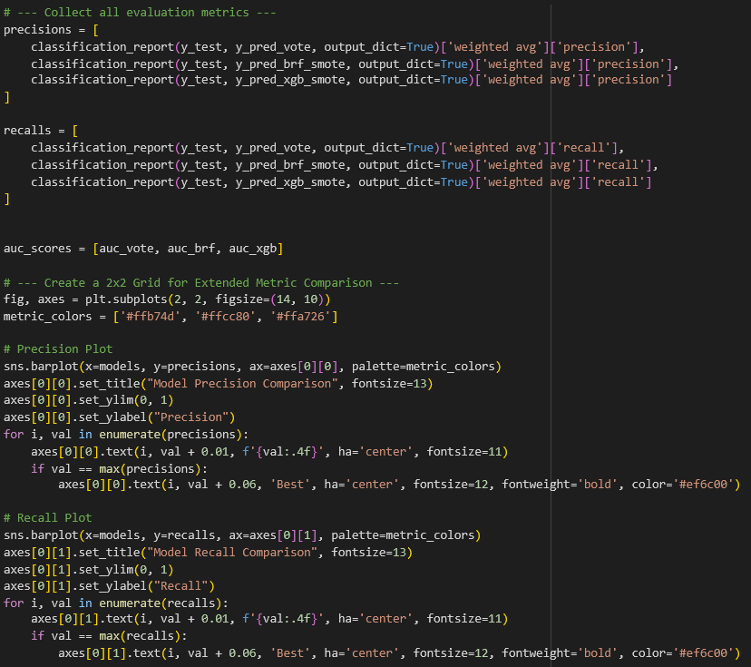
Visualizations- Precision and Recall Plot

Slide 38
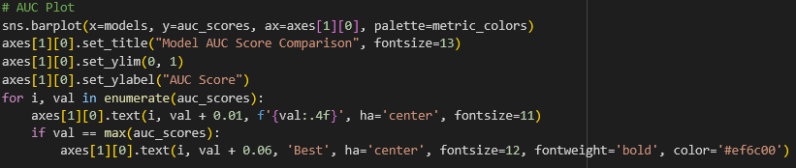
Visualizations- AUC PLOT

Slide 39
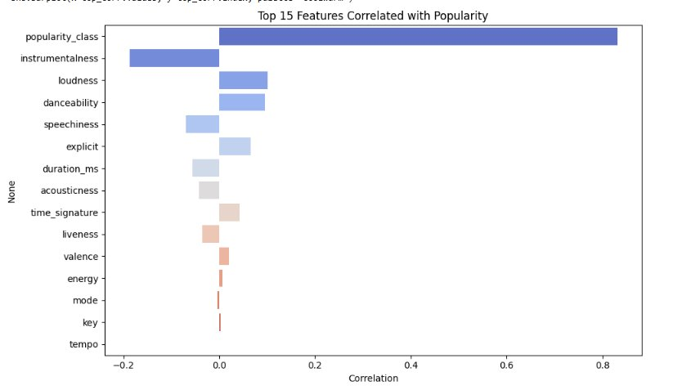
Exploratory Data Analysis (EDA)
Popularity Class (derived from popularity) has a very high correlation (0.82).

Slide 40
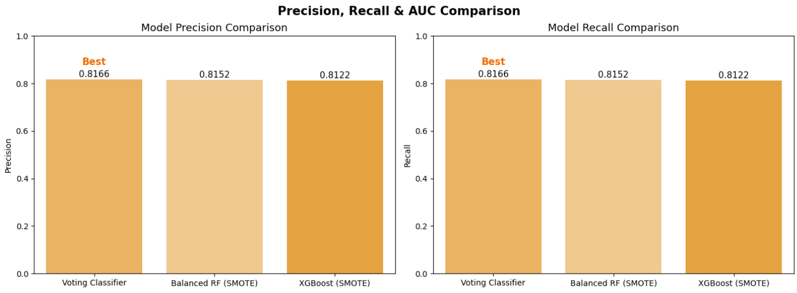
Accuracy & F1 Score Comparison

Slide 41
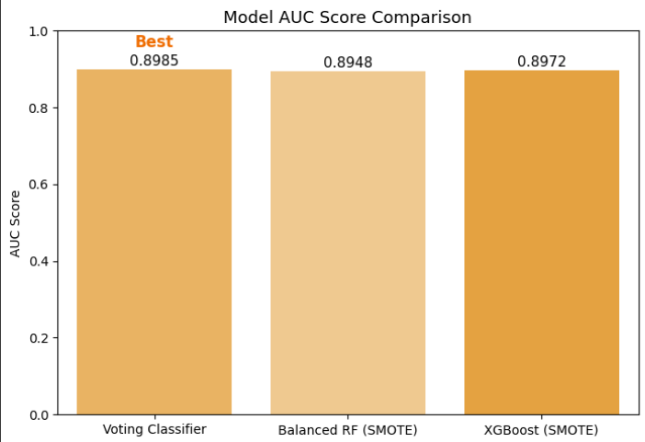
MODEL Comparison Models: XGBoost, Voting Classifier and Balanced Random Forest

Slide 42

Submission Details & Dataset Link
📁 OneDrive Folder: Click here to access submission folder
https://collegedouglas-my.sharepoint.com/my?id=%2Fpersonal%2Fsinghk106%5Fstudent%5Fdouglascollege%5Fca%2FDocuments%2FCSIS%203360%2D003%5FSpotify%5FProject&ga=1
📊 Dataset Used:
Spotify Dataset (Top Tracks 2023) Kaggle Link: https://www.kaggle.com/datasets/iamsouravbanerjee/top-spotify-tracks-2023

